Slide 1
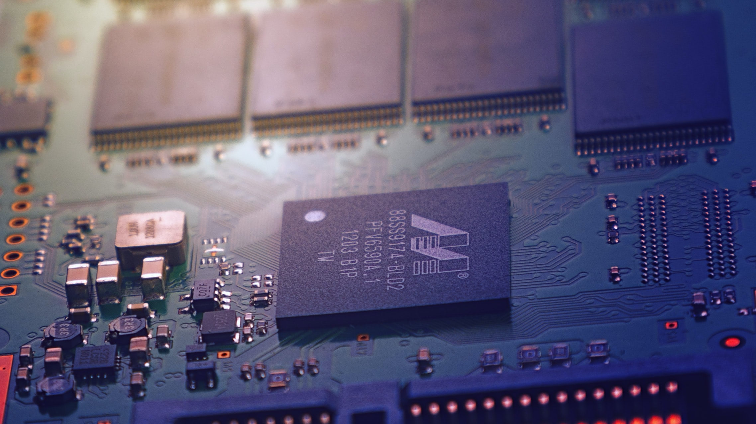
Technology | Trade | Security
A Policy Primer

Slide 2
This policy primer seeks to articulate the linkages between these three areas of policy and has been prepared without third-party funding. It is being made available to the public under a Creative Commons (BY SA) license for free download and dissemination. Readers should note that some of this work also features in other research papers from the same author published at the University of Adelaide.
Corresponding Author
Simon Lacey
Senior Lecturer in International Trade University of Adelaide
simon.lacey@adelaide.edu,au
Photo credit on cover page: Johannes Plenio from pexels,com

Slide 3
Technology | Trade | Security
A Policy Primer

Slide 4
Overview
Choices & Trade-offs
Executive Summary
Trade
Scenarios
Introduction
Security
Technology
Conclusion
Linkages

Slide 5
Executive Summary
We live in an increasingly unstable world, fraught with growing tensions between on the one hand, an established superpower who for decades painstakingly built and led a post-war international economic order that played very much to its own strengths and reflected its own values, and on the other hand a resurgent economic giant that for centuries was the world’s largest economy but which for several hundred years fell behind and which has now risen to new heights and is seeking to remake parts of the global order to better reflect its own needs and priorities. As the established and the newly re-emerging hegemon rub up against one another like two massive tectonic plates, there are bound to be seismic shifts that make their impact felt for both better and for worse.
This policy primer addresses one aspect of these tensions, namely the interface between technology, trade and security. It examines what each of these areas mean in terms of policy priorities for the world’s governments, firms and citizens and how the choices made to achieve objectives in one area can engender negative spill-over effects on the others.
Mostly this primer is intended to explain what linkages exist between these three areas of policy and to elucidate some of the inevitable trade-offs that are made when governments favour one set of outcomes (professed security) over others (innovation and open markets).
This primer also discusses some scenarios in light of recent developments in both China and the United States, particularly efforts to decouple these two trading partners from one another technologically.
The central issue facing these two countries is a fundamental lack of trust. China, whose leaders have a profoundly instilled distrust of Western motives and values, will not rest until they become self-sufficient in those technologies deemed strategically vital for the nation’s future security and prosperity. America for its part, long desired to be able to trust China and hoped to transform the country in its own image of democratic governance, respect for human rights and open and free markets. When this hope began to appear increasingly improbable and China made no secret of its plans to become at least an equal power to the U.S., this massively undercut the case for continued cooperation with China.
Only when China becomes significantly confident that the West is not trying to impede its rise and when the U.S. learns to accept China as it is, will these two great nations be able to trust one another and cooperate as partners. This is admittedly still a long way off at the time of writing. Until then, the other nations of the world need to nudge and coax both China and the U.S. to work together and build trust in small and incremental steps in fora where they already sit at the same table, such at the World Trade Organization or the G20.
This primer ultimately represents a vigorous defence of globalization and continued international cooperation and economic integration, regardless of how unfashionable such a stance has become. The disruptive effects that decades of trade and investment liberalization coupled with technological change has had on labour forces and electorates is clearly something that governments need to do a better job addressing in ways that reduce inequality and create a greater sense of fairness. But doing so does not require abandoning international cooperation and closer economic integration as fundamental tenets of the global order.

Slide 6
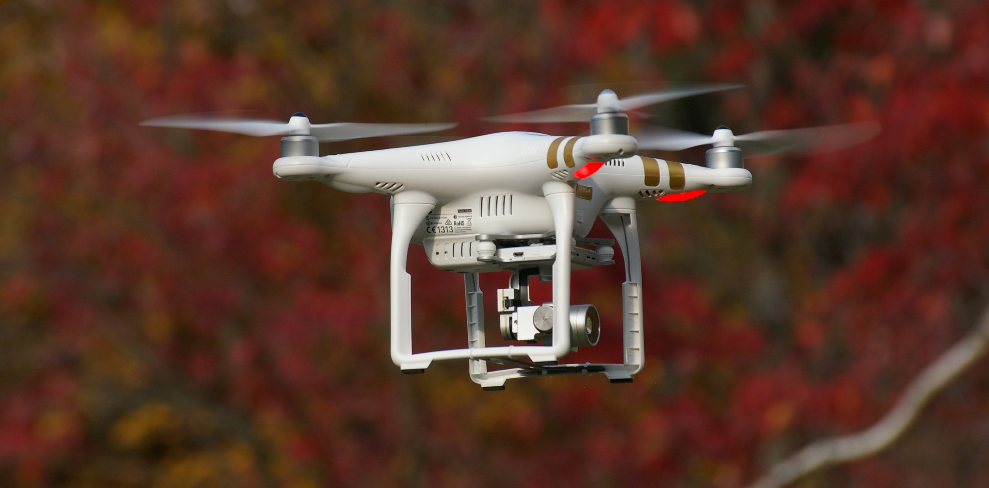
Photo credit: Gianluca Primon from unsplash,com

Slide 7
Introduction
Technology has always been important to human civilization but seems to be playing an increasingly important role in virtually all areas of our lives. As the 21st Century enters its second decade we as a species have become highly dependent on a whole range of technological innovations both seen and unseen. Communication networks offer a prime example of this phenomenon. Previously we relied on these only when we needed to make a phone call or send a fax or telegram. Today we have recourse to this now ubiquitous technology for hundreds of discreet actions that we perform on a daily basis. The issue of our dependence on technology has given rise to various concerns, including who we obtain these technologies from and whether this creates unwanted vulnerabilities in terms of national security. The rise of value chains over the last three decades on the back of increasing trade and investment liberalization as nations sought to maximize the benefits of closer economic integration for their export-competing industries and consumers happened largely in the absence of any pushback from those concerned with preserving national security. That has started to change recently with the rise of China which, despite three decades of reform and opening, is still very much in the grip of a regime that many in the West deem a threat to the values, way of life and security of liberal democracies and market economies all over the world.
This policy primer explores the linkages between the three issues of technological innovation, international trade liberalization and preserving national security. There are obvious tensions between these three areas of policy, and choices made by countries in order to prioritise one over the other will inevitably involve trade-offs. This policy primer seeks to elucidate what some of those trade-offs are and to cut through a lot of the partisan narrative and political posturing that unfortunately seem to accompany any public discussion of these issues today. These are serious issues and the choices made will have significant long-term impacts on billions of lives in both the developed and developing world. The more informed that electorates, policymakers, political leaders and key influencers are on these issues, the better our chances of avoiding costly mistakes, the most obvious one being future armed conflict between the main protagonists in this space, namely the United States and China. To be sure, the rapid rise of China and its adherence to a model of political and economic governance that differs in many ways from those which dominate in the West has proven disruptive and disconcerting, but is no reason to jettison tried and trusted principles that have underpinned more than six decades of economic growth, prosperity and rising living standards.
This primer discusses each of these separate policy areas in terms of the main objectives governments typically pursue and what underlying conditions are optimal in order to maximize benefits and outcomes in each of these areas. It then discusses the linkages between these three fields and the trade-offs inherent to different policy choices. It postulates that governments need to be cognizant of what they can do to promote technological innovation in ways that are not overly restrictive in terms of openness to international trade and investment, while at the same time not undermining their national security interests, since all three of these goals are important in their own way. Citizens need to hold their governments accountable for making choices that uphold and do justice to these important policy areas and that don’t sacrifice the national interest for the sake of political expediency, misplaced ideology or for the benefit of political and economic elites. We live in a time of growing tension and instability that risk wreaking long-term havoc on the most vulnerable members of society and the poorest countries in the world. The need for sensible, rational and intelligent policy choices to head off disaster and to ensure continued global economic growth and prosperity for all has never been greater.

Slide 8

Photo credit: Hitarth Jadhav from unsplash.com

Slide 9
Technology & Innovation
It would probably not be an overstatement to say that technology is what defines us as a species, at least in terms of separating us from the millions of other lifeforms that have lived on this planet both past and present. Of course, humans are also defined in many other ways but our ability to imagine, conceptualize and develop new creations or repurpose existing materials and phenomena to modify our environment in ways that make our lives on this planet easier, safer, healthier, longer, more productive are certainly one of the most compelling aspects that differentiate us from the rest of Earth’s living things.¹
In so many of history’s most decisive moments, technology and its purposeful exploitation were the defining factors that changed the lives and destinies of millions if not billions of people. It was technology that has allowed humankind to massively mitigate the impact of diseases like mumps, measles, rubella and polio. It was technology that allowed us to first travel faster than a horse, it was technology that put mankind on the moon, and it is technology that may one day allow humans to travel to and live on other planets, thereby making us an inter-planetary species. ²
Technology has likewise played a decisive role determining outcomes in instances of armed conflict throughout human history, with the most technologically advanced combatants usually prevailing over less technologically advanced foes.
For almost every man woman and child living on the planet today, technology plays an integral part in their daily lives. This is particularly true of life in advanced industrialized countries and emerging markets. We have historically unprecedented access to information in terms of both the scope of the information available to us and the ease with which we can tap into it, literally by doing nothing more than consulting our mobile phones. It has never been easier to connect to and collaborate with people that are geographically far removed from us, often living and working on entirely different continents and in completely different time zones.
This has all been made possible thanks to technology and the innovation driving technological change. Without innovation there is no technological advancement, so innovation is crucial to continuously advancing in terms of what is technologically possible.
Technology and the innovation that enables it are also key determinants of the success of companies and nations. Just as in previous centuries and millennia, technological superiority when applied effectively allowed one group of people to dominate and impose their will on another, today having a technological edge over another company or another nation can dictate important outcomes like market share and profitability for companies, and economic power for nations.³
Economic power is likewise one of the key determinants for countries’ abilities to influence outcomes in their favour and guarantee their sovereignty and prosperity. The positive correlations between innovation and other desired outcomes is unmistakable (see graphic on next page), which is why companies and nations put so much emphasis on supporting innovation and technology.
Technology is thus an area of intense competition between nations and today we see this competition taking place in ways that seem to be stoking bitter rivalries. Nowhere is this more apparent than in the tensions currently surrounding relations between the United States and China,

Slide 10
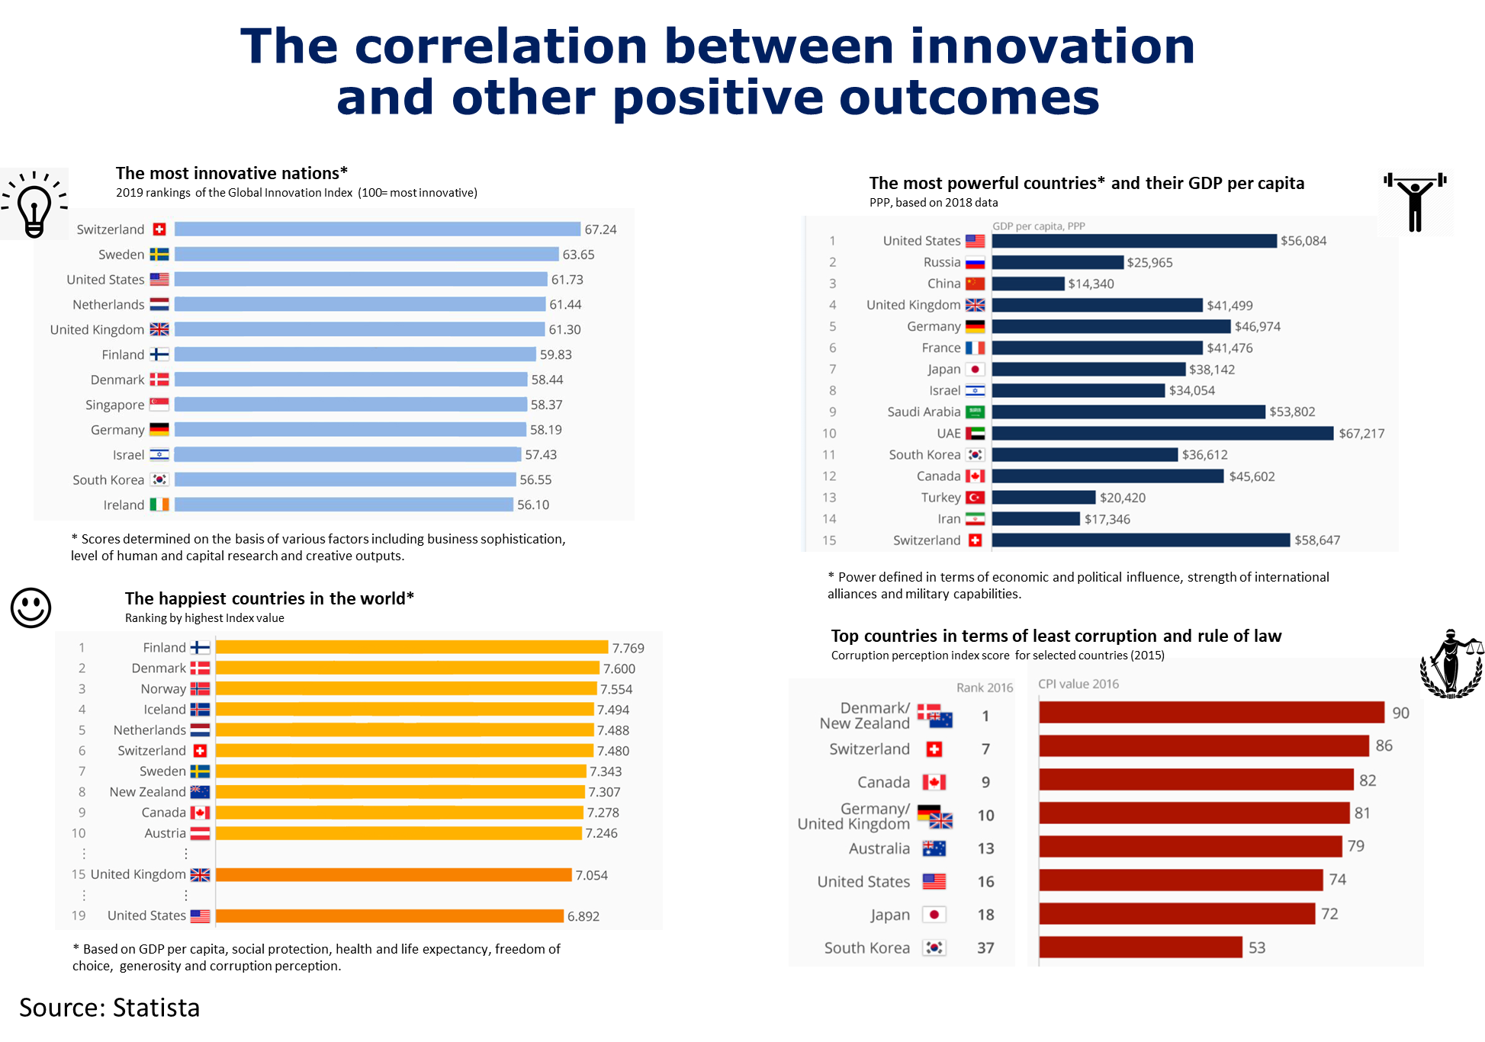
Many of the countries that appear in the top ten of the most innovative reappear in the other rankings on positive outcomes such as power, GDP per capita, happiness and low levels of corruptions. Innovation and the technology it brings with it are fundamental to prosperity, power and quality of life.

Slide 11
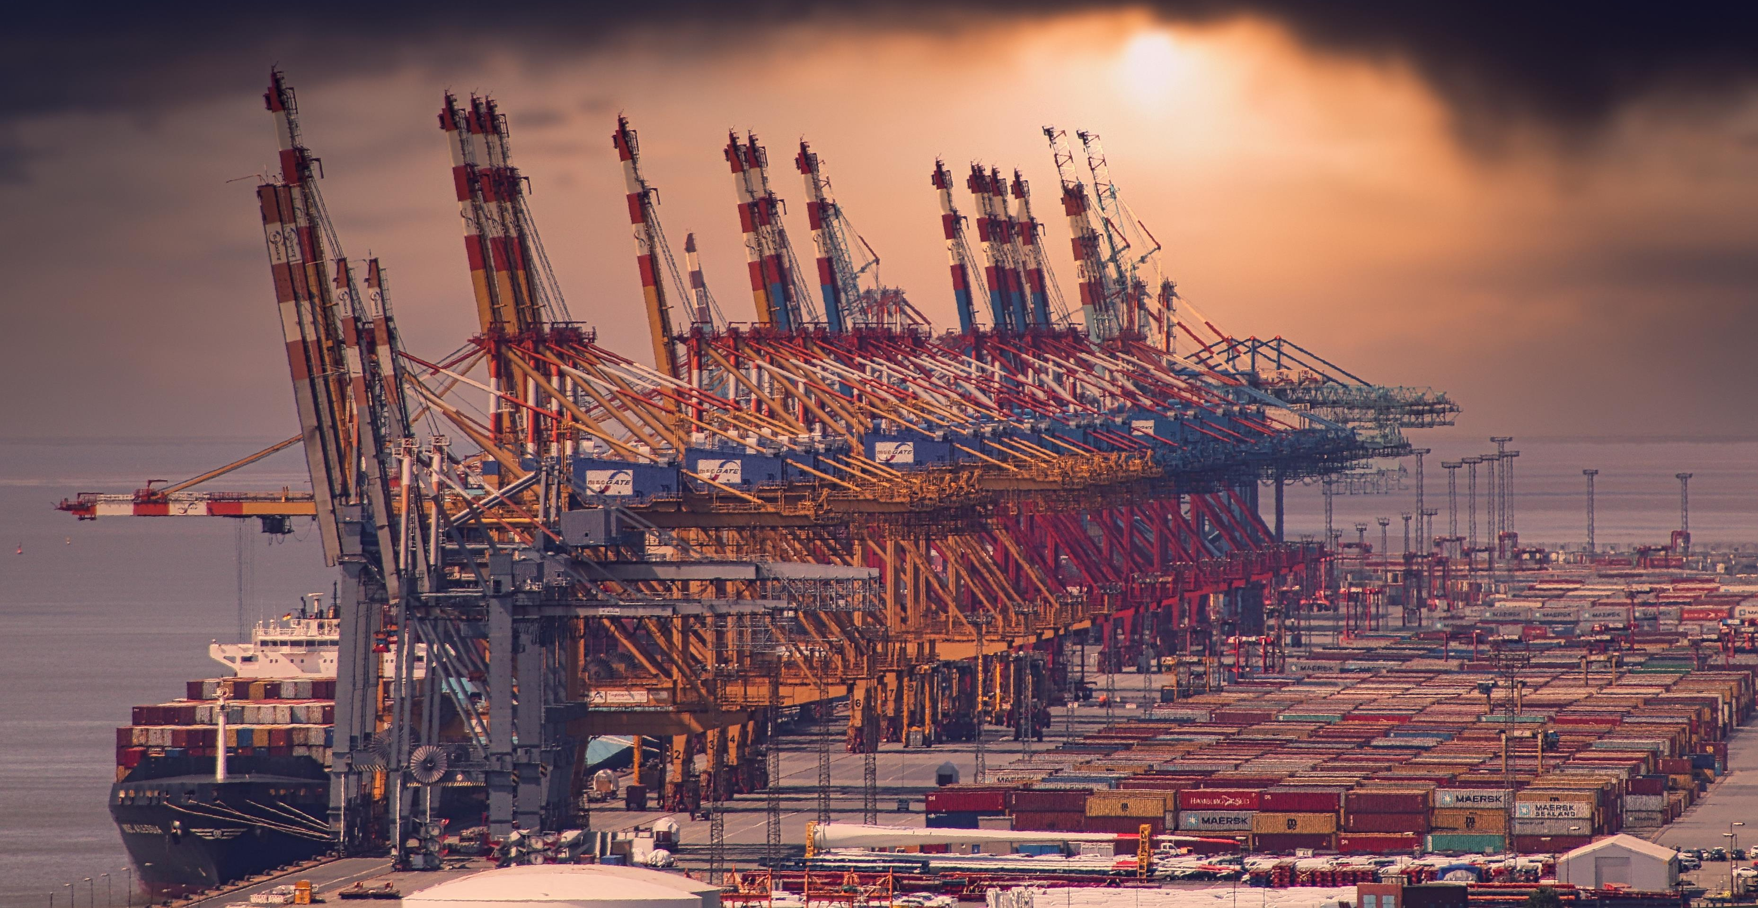
Photo credit: Ingo Moringo from pixabay.com

Slide 12
Trade
Trade means different things to different people. At one very fundamental level, trade can be equated with economic freedom, since the specialization that is intrinsic to trade allows each of us to focus our energies on those things we do well in order to guarantee our economic security, rather than having to be completely self-reliant. A world where every single person had to satisfy each and every one of his or her needs personally, would be one of interminable drudgery. Economies that are based on the division of labour and the specialization intrinsic to such an organizational approach are ones in which people are infinitely more fulfilled, happier, healthier and more secure.⁴ Trade is an extension of this division of labour and is the mechanism by which we exchange the goods, services or intangibles that we spend our time producing for the goods, services and intangibles that others have produced and that we want or need.
Trade is thus essential to the way modern economies function. International trade is the extension of this principle across borders and in theory allows countries to specialise in those goods, services and intangibles that they are able to provide most efficiently (in either absolute or relative terms) and to exchange them for other desired or needed goods, services or intangibles produced in other countries. The theories of absolute and comparative advantage that explain how and why countries choose to specialise in the production of and trade in certain products were developed hundreds of years ago but are still relevant today.
This despite the fact that today we live in a global economy that is infinitely more complex and characterized by much higher degrees of specialization and product sophistication than was the case when international trade between nation states first emerged several centuries ago.
International trade in the modern era is governed by a set of principles that for all intents and purposes were first codified as a set of international treaty rules after the Second World War and which have evolved to some degree since then. The most important of these is arguably non-discrimination, which requires that countries afford equal treatment to foreign products regardless of which trading partner they emanated from, and also requires that countries treat foreign products the same as domestically produced like products once they are on the domestic market. This is about basic notions of fairness and allowing different firms to compete against one another on a level playing field irrespective of where they originate from or where their products are made.⁵
Another important principle of international trade is continued liberalization through successive rounds of trade negotiations, meaning that trade barriers should in theory be getting progressively lower over time. Yet another, more recent principle of international trade is that when governments enact technical regulations that end up constraining how products can be sold on markets, then such interventions should be minimally trade restrictive, meaning they should only negatively impact international trade to the extent necessary to achieve the legitimate regulatory objective they purportedly pursue. ⁶
Trade, like technology is another area where companies and countries compete in order to gain a strategic advantage over one another. Up until fairly recently, trade, like technology, was seen as something overwhelmingly positive. But recently the tables have turned, so that electorates, particularly in advanced industrialized countries, have started to see trade, and the cross-border economic integration it facilitates as being potentially threatening to their economic livelihoods and thus their way of life. We are unmistakably experiencing a backlash against globalization and trade liberalization on the part of many working people as well as among certain policy elites in countries such as the United States, many parts of Europe, and a growing number of developing countries, particularly in Africa and Latin America.⁷
The principles upon which the current trading system was built, particularly non-discrimination, eschewing protectionism by providing a level playing field, and the need to continually pursue closer economic integration have all come to be questioned either explicitly (through outright rejection of these principles) or implicitly (through specific policy choices that set aside or undermine them) by an increasing number of trading nations, big and small. The sudden and dramatic rise of China to become the world’s largest trading nation and the world’s second largest economy, has been a source of major disruption and has caused tensions to erupt between major trading nations and China. One of the areas where these tensions have manifested themselves most acutely is in the area of international trade, another being technology.

Slide 13
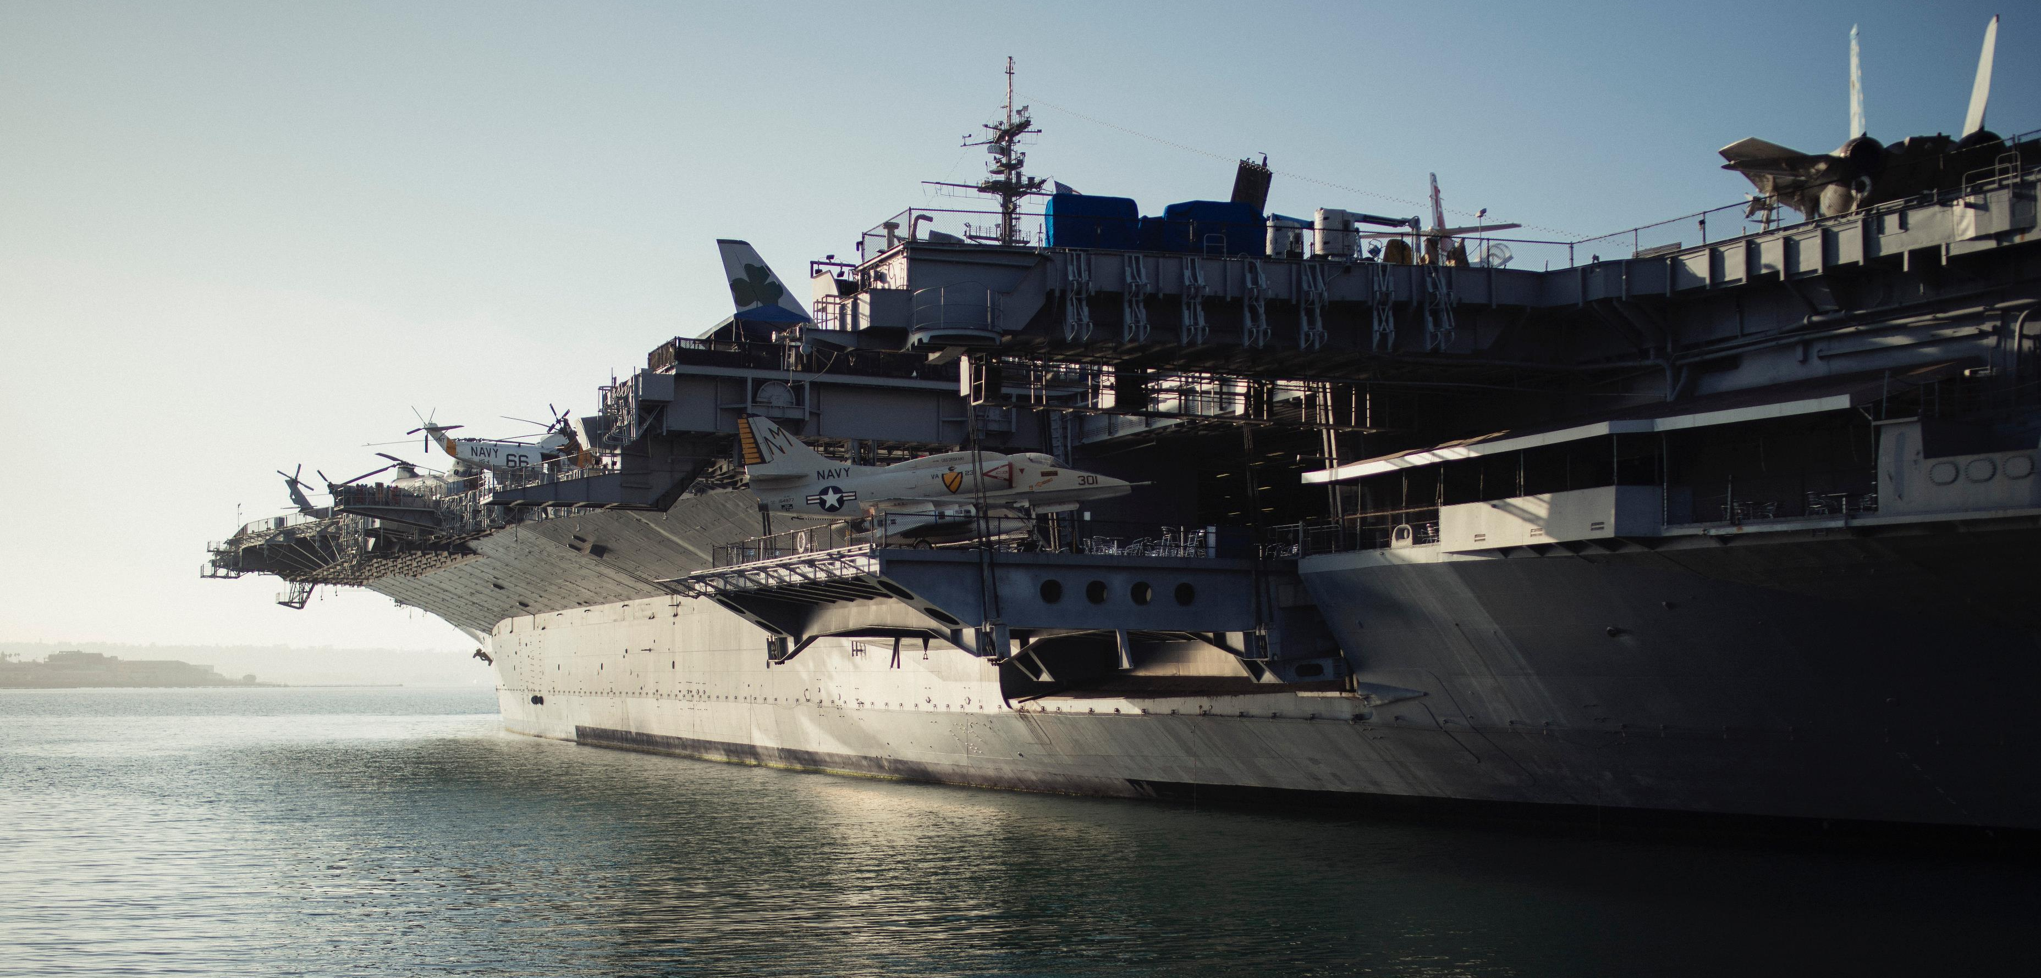
Photo credit: Michael Afonso from unsplash,com

Slide 14
Security
The concept of security has evolved over time in conjunction with the changing nature of conflict and the way in which the threats that societies and countries face to their continued existence, welfare and prosperity have likewise continued to change through the ages. Since the turn of the 20th Century, wars became truly global in scale (although some historians have argued that global wars manifested themselves as early as the 1700s). The 20th Century also saw the advent of wars that were both highly mechanized, fought on an industrial scale, and that involved armed confrontation not only on the ground, but also in the air and under the sea. ⁸
Historians also disagree about the value or contribution of war to the advance of civilization. However, the evidence seems to suggest that military conflict has driven humanity to develop and master increasingly complex (and lethal) technologies as well as increasingly sophisticated forms of organization and governance. As weapons have become increasingly lethal, to the point where weapons of mass destruction such as thermonuclear inter-continental ballistic missiles massively increase the cost of waging total war, the world has – somewhat paradoxically - become a more peaceful or at least less violent place overall since even before the advent of nuclear weapons in 1945.⁹
Following the end of the Cold War in 1989, the world entered what was perhaps an unprecedented period of unipolarity in which only one nation, the United States, towered over the rest of the world in terms of its military superiority but also its technological sophistication and economic strength. However, this was not to last and recently we have re-entered a period of great power rivalry, even though, for now, the United States remains clearly ascendant, with its lead over revisionist powers only shrinking in relative and not absolute terms.
Because the cost of war is now so prohibitive, but also because countries have become increasingly interconnected and interdependent, the onus of big power rivalry has shifted from one defined almost exclusively in terms of comparative military capabilities to one where nations compete across a wide range of – often complimentary - battlefronts. By the same token, increasing interconnectedness and mutual dependence have also led to a broadening of potential attack vectors and to a deepening of the destructive impact a successful assault on any one of these vectors might entail.¹⁰
For this reason, there has been an incremental but discernible shift from defining national security in the conventional but narrow terms of physical control over defined territories and their inhabitants, to one that encapsulates a broad range of strategically significant endowments, factors and capabilities.
Today, nations define security in response to the various attack vectors they identify, which themselves are a function of perceived vulnerabilities.
The 2017 U.S. National Security Strategy breaks down its objectives into a set of four over-arching pillars, with the first being to protect the American people, the Homeland and the American way of life, thereby signifying a more conventional understanding of potential threats and their appropriate responses. The remaining three pillars, however, display a more holistic appreciation of the potential threats to U.S. pre-eminence and how to meet them. The second pillar is promoting American prosperity (i.e. economic might); The third pillar is preserving peace through strength (i.e. deterrence, albeit across a range of both conventional and newer battlefields such as space and cyberspace); and finally the fourth pillar is to advance American influence (through non-military means). ¹¹
ThIS holistic approach to defining and defending national security allows one to appreciate that we are living in a more complex world than in previous centuries, and that this complexity clearly gives rise to linkages between technology, trade and security that have perhaps always existed in one form or another, but which given the pervasive level of international economic integration and mutual inter-dependence today, increases the negative impact of any increase in tensions and their implications for individuals, firms and societies, discussed in more detail in the next section (Linkages).

Slide 15
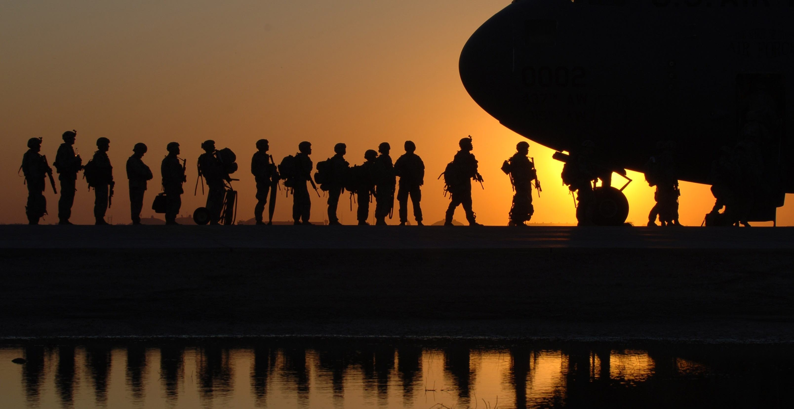
Photo credit: unknown from pixabay.com

Slide 16
Linkages
Technology & Trade
Trade & Security
Security & Technology
The linkages between technology and trade are relatively obvious on the one hand, although there are also more subtle ways in which these two phenomena are linked. Throughout history one of the ways through which different societies and countries interacted was of course through trade and this allowed for different technologies to be disseminated and for innovation to take place.¹² Most of this traffic was initially from East to West, at least up until the modern era, after which the West became more technologically advanced.¹³ Today East and West are rapidly becoming more evenly matched in terms of technology and innovation, which is itself a source of profound tension.
Innovation requires the free flow of ideas, people and products across markets, so open trade and investment regimes are important if firms and countries are to keep innovating and not fall too far behind the technological frontier.¹⁴ This is particularly true of foundational and enabling general purpose technologies that are fundamental to the supply of so many other products and services like communication networks, sensor technologies, or machine learning and big data analytics.
Governments enact many policies in the area of science, technology and innovation that can have an impact on trade, as well as adopting many trade-policy measures that risk endangering their access to important technological developments. Some of these are discussed in more detail in the next section (Choices & Trade-offs).
Because countries take a more holistic approach to defining potential threats today, this has profound implications for the level of trade and investment openness they are willing to tolerate, or rather the degree to which they are prepared to sacrifice regulatory autonomy and national sovereignty for the sake of international economic cooperation. The increasing level of economic integration that has taken place between different countries in the last 60 years has also carried with it a range of consequences for their ability to safeguard their own security.
In some cases, this was an entirely deliberate strategy, with the desired result being to create a sense of collective security and deny countries the ability to take up arms against one another. This was very much one of the core rationales for binding the economies of France and Germany together after the Second World War.¹⁵ Much of the post-war multilateral institution building that occurred was predicated on the notion that a world more closely integrated economically though trade would be a less belligerent and thus a more secure place for peaceful nations to co-exist. ¹⁶
Today, tensions are emerging as the core principles that have underpinned trading relations between nations such as non-discrimination, continued trade and investment liberalization and the least-trade restrictiveness of measures, begin to rub up against a more holistic and assertive understanding of what countries can and should do to safeguard their perceived national security interests.
The linkages between security and technology should be the easiest to understand, since wars are more often than not won by those with the most advanced weaponry and the best organized processes for collecting intelligence and exploiting information gaps, both of which rely on superior technology and innovation. ¹⁷
Both the Second World War and the Cold War saw the major antagonists in a race with one another to develop and deploy superior technologies. When the United States perceived that the Soviet Union had developed superiority in both conventional forces in Europe as well as nuclear weapons, then Secretary of Defence Harold Brown turned to the U.S.’s lead in technology to develop what became the “off-set strategy” in an effort to use innovation and technology to off-set the USSR’s perceived lead.¹⁸
Today, the race to be at the technological cutting edge as a part of countries’ military posture is still on, albeit it with different competitors. In addition to this, threat perceptions have evolved so that the notion of critical national infrastructure encompasses a broad array of national assets that must all be protected against attack, meaning that key technologies such as semiconductors, and ubiquitous communication networks take on new significance from the perspective of national security.¹⁹

Slide 17
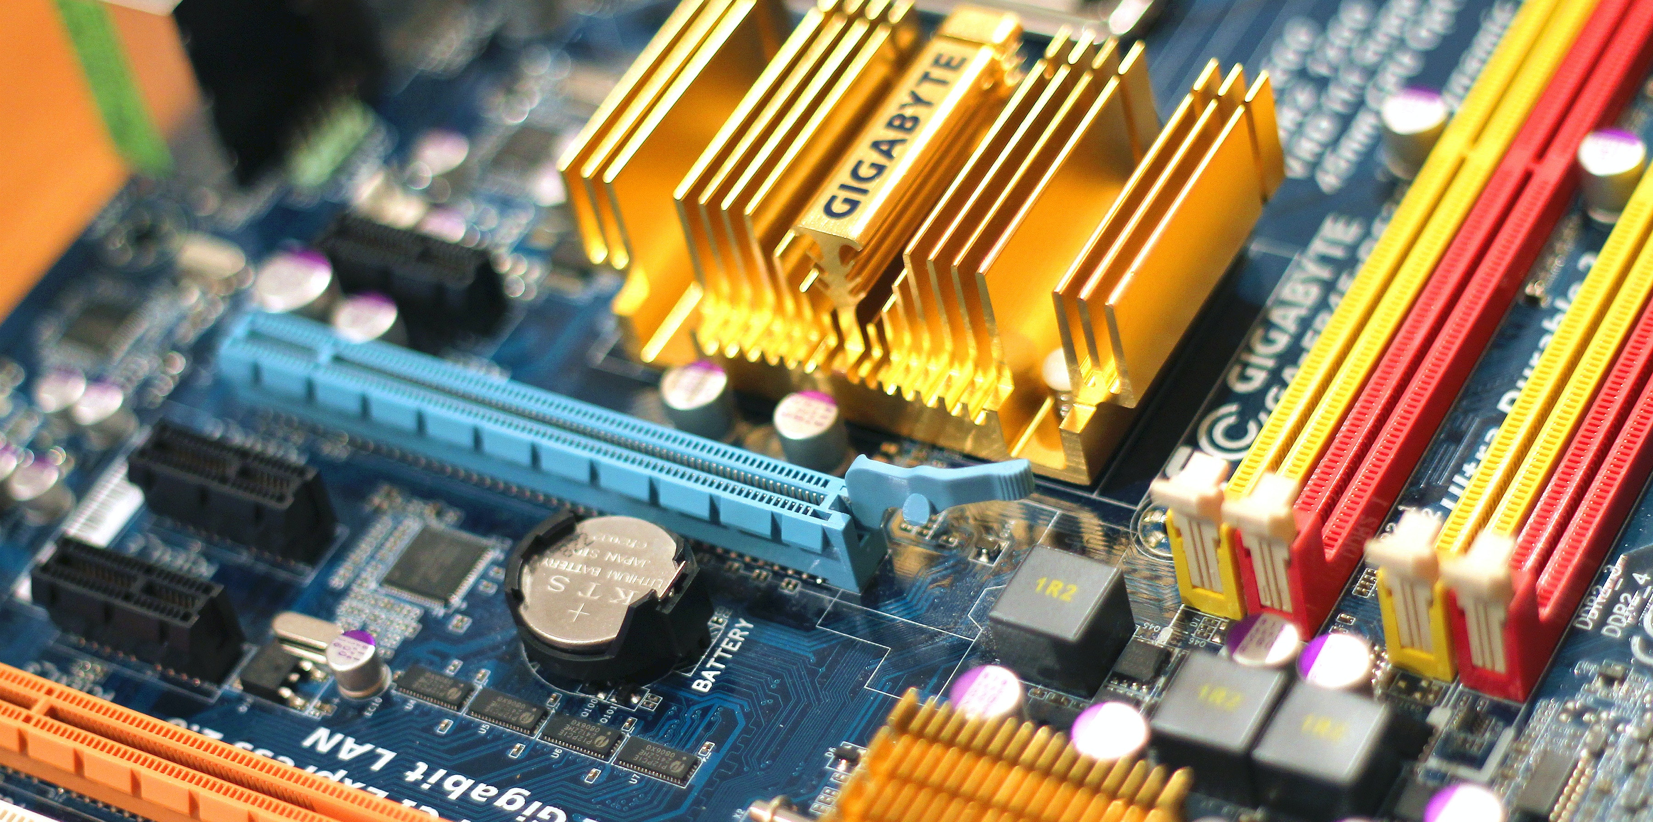
Photo credit: Jeshoots from pexels.com

Slide 18
Choices & Trade-offs
Better or Worse Technology
Real or Perceived Security
Free Trade or Protectionism
Because countries see themselves increasingly forced to exclude technology providers based on perceptions of underlying or inherent security vulnerabilities, countries have some difficult choices to make.
We have seen this in the investment space where many start-ups have been denied funding or access to similar resources because the financial support or know-how on offer originated in a country deemed to be a strategic competitor or was otherwise perceived to be “compromised”.²⁰
We have seen this in the area of 5G communications technology, where for the very first time leadership is in the hands of a company from China.²¹ After decades of being followers in these key technologies a Chinese firm has reportedly assumed a position of leadership, although opinions differ on how this was achieved. But a small minority of nations have questioned whether they are still willing to comply with their commitments under the rules- based multilateral trading system now that China has emerged as a technological leader.
We have also seen nations such as Japan, China, the U.S. and Australia impose restrictions on market access based on the country of origin of suppliers, and this inevitably raises the question whether in doing so, they have forced their firms and citizens to settle for less advanced technology as the quid-pro-quo for what may be a false sense of security. ²²
How to achieve genuine security in an age where the attack vectors are so diverse and are constantly evolving? That is the challenge that governments face in an era of increasing complexity. One approach could be by focussing on resiliency rather than securing against egress across each and every possible attack vector. For example, the nuclear power industry in advanced industrialized countries achieves acceptable levels of safety through an approach known as “integrated defence in depth”, whereby safety concerns are taken into account in reactor design, hardware performance, but also in terms of human and organizational elements.²³
In the area of cybersecurity, experts tend to agree that restrictions based on the nationality of a provider or supplier contribute virtually nothing to achieving any improvement in security. Instead, all parts, components, software coding, access protocols, and other integrative elements of a product or system need to be subject to risk mitigation frameworks such as those achieved through regular reviews and security audits.²⁴
What’s more, because the attack vectors are so numerous and multifaceted, achieving 100% cybersecurity is impossible, so that a systemic resilience approach is again required. This means relying on multi-vendor strategies, and building-in alternative and spare capacity as well as other redundancies as part of any network or system. This raises costs, as do the performance of recurring supply-chain audits.
Any measures that governments enact to safeguard security and which are likely to have a bearing on technology and innovation need to be carefully weighed in terms of both their impact on international trade and their propensity to have unforeseen consequences. Reducing such negative externalities is best achieved by consulting widely before enacting regulations so that stakeholders from industry, trading partners, consumer groups and civil society can all be heard. This approach is in fact the very basis of modern and widely accepted notions of sound regulatory governance.
Restrictions that reduce the number of eligible suppliers or which exclude certain technologies need to be justified in terms of higher-order public policy objectives because of the high costs they impose on societies, citizens and firms. National security is certainly such a higher-order goal, but any measures imposed in invocation of national security have to be carefully weighed in terms of the costs they impose and the benefits they promise.²⁵
When enacting measures that result in trade restrictions governments must be conscious of the fact that this affords any remaining suppliers monopoly rents and is almost certain to have damaging effects on competition and innovation in the short, medium and long terms. Any such regulatory measures need to be carefully scrutinized with regard to their effect on the competitive landscape, their proportionality and their ultimate effectiveness in achieving the goals for which they were purportedly enacted. ²⁶

Slide 19
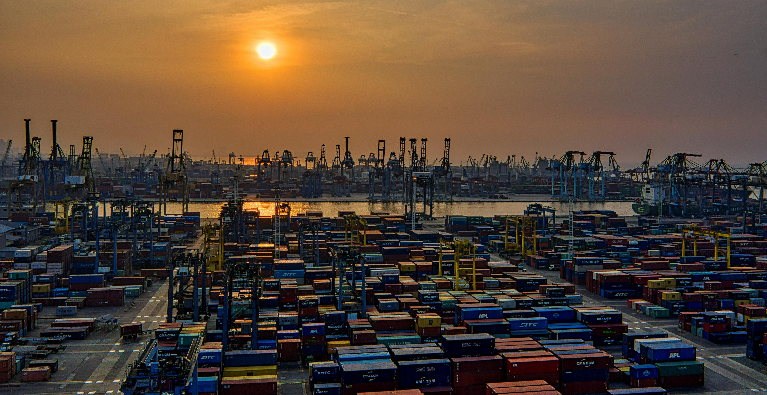
Photo credit: Tom Fisk from unsplash.com

Slide 20
Scenarios
Decoupling and Fragmentation
Cooperation and Prosperity
Thinking the Unthinkable
The United States is clearly heading down a path of technological decoupling from China, which even many experts believe makes limited sense if done surgically and with respect to a small number of essential components that are critical to the country’s defence capabilities. ²⁷
China for its part, seems to have made this decision for itself some time ago, and has for several years now been trying to increase the level of indigenous content in various parts of its technology ecosystem, particularly the information and communications technology space.²⁸ In some ways, the United States is actually just reacting to a perceived lack of reciprocity for its own firms in China, whereas in other ways the pivot towards decoupling from China technologically is in response to a reappraisal of China from partner to competitor to future strategic threat.
Other trading partners of both the U.S. and China have made it clear that they do not want to have to choose between these two economies and that decoupling from China is not an option for them.²⁹ This is true at the time of writing for example with both Germany and Singapore.
The risk of technological decoupling is that it extends beyond technology to other areas of the economy and becomes a broader trend that threatens to undo the many benefits achieved through decades of closer economic integration between what are now the world’s two largest economies. Decoupling also results in broader systems fragmentation which artificially raises costs across the whole economy.
Another scenario is that the United States and China learn to trust one another enough in order to resume their many decades of fruitful cooperation, which has produced enormous benefits for the people and firms of both countries and for the world more generally.
This would need to be done in small incremental steps through a series of trust-building measures in multilateral fora at which the two countries already sit at the same table, such as the World Trade Organization, the G20, and others, and where collective action problems require these two countries to work together to achieve progress.
Middle powers and other major stakeholders such as the European Union, Singapore, and Australia should seize the initiative to find areas of common interest where the U.S. and China can be coaxed into working together to achieve important goals that are in both countries’ interests.
The disruption that closer economic integration and technological change have combined to wreak on labour forces and electorates needs to be addressed more constructively and effectively without questioning the merits of globalization as a force for continued peaceful co-existence and prosperity.³⁰
The trade tensions we have seen manifested over the last several years were already starting to negatively impact economic growth in both China and the United States even before COVID-19 unleashed both a global health crisis and an unprecedented economic downturn. If governments around the world fail to rally to the cause of continued economic cooperation the trade war initiated by the Trump administration and the measures governments take to restart their own economies could spell an end to an era of multilateral, regional and bilateral cooperation through the short-sighted pursuit of beggar-thy-neighbour protectionism.³¹ This could spell the final death knell for the rules-based trading system and have economic consequences even more damaging than the massive upheavals the global economy has had to endure over the last several years.
In addition to this is the inescapable fact that the more the U.S. and others continue to treat China as a rival and even a potential adversary, the more likely this is to become a self-fulfilling prophecy.
In the years after the Second World War, the triumphant Western powers embarked on a far-sighted and ambitious program of international cooperation and closer economic integration, knowing that this was the best way to avoid future conflict. Nothing in this calculus has fundamentally changed. If countries want to avoid going to war, they must remain open to trade with one other, and this includes in the area of technology and innovation.

Slide 21

Photo credit: Randy Fath from unsplash.com

Slide 22
Conclusion
Technological innovation, trade openness, and national security are all important areas in their own right and some trade-offs between these three areas are inevitable.
However, we need to avoid economies that achieve nothing of their purported objectives and which only serve to further the narrow interests of powerful political and economic elites.
The last several years have seen an escalation in tensions that many would argue were inevitable given how fundamentally different the two main protagonists are in terms of their systems of political governance and economic ideologies. Scratch beneath the surface however, and there is much that unites both the U.S. and China in terms of common interests and desired economic and geopolitical outcomes.
The fundamental element missing from the relationship is mutual trust and this can only come once China is confident that the West in general and America in particular are not trying to hinder China’s rise, and when the United States accepts the reality that China is ruled by leaders who do not share its liberal democratic values or its predisposition towards free markets.
For now, other nations and trading partners of both these economies need to work together to nudge and coax these two powers towards incremental trust-building steps that foster greater understanding and achieve common goals in important areas where collective action is required and where China and the U.S. can cooperate without the destructive zero-sum dynamics that has plagued much of their relationship until today.

Slide 23
End Notes
19 Alex Capril, US-China Tech War and Semiconductors: How a New Era of Techno-Nationalism is Shaking up Semiconductor Value Chains, 2020, Hinrich Foundation, https://www.hinrichfoundation.com/research/white-paper/trade-and-technology/semiconductors-at-the-heart-of-the-us-china-tech-war/.
Mercedes Ruehl , James Kynge and Miles Kruppa, Chinese venture capital investment in US falls to four-year low, “Financial Times”, 2 October 2019, https://www.ft.com/content/440fecb8-e4cd-11e9-b112-9624ec9edc59.
Sarah Feldman, Huawei is Leading the Race to Develop 5G, “Statista”, 22 May 2019, https://www.statista.com/chart/17536/mobile-network-standards/.
Nicolas Botton and Hosuk Lee-Makiyama, 5G and National Security: After Australia’s Telecom Sector Security Review, ECIPE, 2018, https://ecipe.org/publications/5g-national-security-australias-telecom-sector/.
Organization for Economic Cooperation and Development, A systemic resilience approach to dealing with Covid-19 and future shocks, 28 April 2020, http://www.oecd.org/coronavirus/policy-responses/a-systemic-resilience-approach-to-dealing-with-covid-19-and-future-shocks-36a5bdfb/.
P.W. Singer and Allan Friedman, Cybersecurity and Cyberwar: What Everyone Needs to Know, 2014, Oxford University Press, Oxford (UK).
Daniel J. Ikenson, Blacklisting Huawei Could Cost Trillions, so Let’s Look Before We Leap, Cato Institute, 5 July 2019, https://www.cato.org/publications/commentary/blacklisting-huawei-could-cost-trillions-so-lets-look-we-leap.
United Kingdom Intelligence and Security Committee of Parliament, Statement on 5G Suppliers, 19 July 2019, http://isc.independent.gov.uk/.
David P. Goldman, US-China decoupling: a reality check, “Asia Times”, 14 April, 2020, https://asiatimes.com/2020/04/us-china-decoupling-a-reality-check/.
James McGreggor, China’s Drive for “Indigenous Innovation”: A Web of Industrial Policies, U.S. Chamber of Commerce, 2011, https://www.uschamber.com/sites/default/files/documents/files/100728chinareport_0_0.pdf
Federation of German Industries, China – Partner and Systemic Competitor: How Do we Deal with China's State-controlled Economy? 2019, https://english.bdi.eu/publication/news/china-partner-and-systemic-competitor/.
Edward Alden, The Global Trading System: What Went Wrong and How to Fix It, Council on Foreign Relations, 13 May 2019, https://www.cfr.org/article/global-trading-system-what-went-wrong-and-how-fix-it.
Chad Bown, COVID-19 Could Bring Down the Trading System: How to Stop Protectionism From Running Amok, “Foreign Affairs”, 28 April 2020, https://www.foreignaffairs.com/articles/united-states/2020-04-28/covid-19-could-bring-down-trading-system.
Melissa Hogenboom, The traits that make human beings unique, “BBC.com/future”, 6 July 2015, https://www.bbc.com/future/article/20150706-the-small-list-of-things-that-make-humans-unique.
Yuval Noah Harari, Homo Deus: A Brief History of Tomorrow, 2016, Harvill Secker, London (UK).
Jorge Niosi (ed.), Technology and National Competitiveness, 1991, McGill-Queen's University Press, Montreal (CA).
Adam Smith, An Inquiry into the Nature and Causes of the Wealth of Nations, 1776, William Strahan, London (UK).
John H. Jackson, World Trade and the Law of GATT, 1969, Mitchie, Charlottesville (VA).
Article 2.2 WTO Agreement on Technical Barriers to Trade.
Joseph E. Stiglitz, Globalization and Its Discontents Revisited: Anti-Globalization in the Era of Trump, 2017, W. W. Norton & Company, New York (NY).
Azar Gat, War in Human Civilization, 2006, Oxford University Press, Oxford (UK).
Ian Morris, War! What Is It Good For?: Conflict and the Progress of Civilization from Primates to Robots, 2014, Farrar, Straus and Giroux, New York (NY).
Michael J. Mazarr, Mastering the Gray Zone: Understanding a Changing Era of Conflict, 2015, United States Army War College Press, Carlisle Barracks (PA).
National Security Council, National Security Strategy of the United States of America, 2017, White House, Washington (DC).
William J. Bernstein, A Splendid Exchange: How Trade Shaped the World, 2008, Atlantic Monthly Press, New York (NY).
Peter Frankopan, The Silk Roads: A New History of the World, 2015, Bloomsbury, London (UK) and New York (NY).
Steven Johnson, Where Good Ideas come From, 2011, Riverhead Books, New York (NY).
Luuk van Middelaar, The Passage to Europe, How a Continent Became a Union, 2013, Yale University Press, New Haven (CT).
Clair Wilcox, A Charter for World Trade, 1949, MacMillan, New York (NY).
Martin van Creveld, Technology and war from 2000 BC to the present, 1989, Free Press, New York (NY).
Linda Weiss, America Inc.? Innovation and Enterprise in the National Security State, 2014, Cornell University Press, Ithaca (NY).

Slide 24

The Wars to Come
Joining the dots … to avoid
www.thewarstocome.info

